Slide 1
Analyzing Effectiveness
of the
True Performance Program
Capstone Project 2019 – Highmark Inc
Moe Wolf (MSHCPM ‘20)
Jonathan Dyer (MISM ‘19)
Jeremiah Humes (MSHCA ‘20)
Manjiri Kshirsagar (MSHCPM ‘20)
Faculty Advisor: Jim Jordan

Slide 2
Executive Summary
Value Based Reimbursement
Overview of True Performance Program
Exploratory Data Analysis
Next Steps
Validate structure of program to KPIs
State of VBR in healthcare space
Summary statistics, correlations

Slide 3
Value Based Reimbursement (VBR)
VBR: Using process, quality, and efficiency measures as placeholders for difficult to measure outcomes, in order to inform physician reimbursement.
Examples: Breast cancer screenings, depression screenings, care plans for high-risk patients¹
The state of VBR
Mixed results from most:
“Pay for performance programs as currently implemented are unlikely to be successful in the future, even if their timeframes are extended” (BMJ, 2018)²
“In 2017, medical costs for patients attributed to primary care practices in Humana’s value-based reimbursement models for Medicare Advantage were 15.6 percent lower compared to Medicare fee-for-service” (Humana, 2018)³
“Evidence that HVBP has led to lower mortality rates is lacking. Nations considering similar pay for performance programs may want to consider alternative models to achieve improved patient outcomes.” (BMJ, 2018)⁴
1:https://qpp.cms.gov/mips/explore-measures/quality-measures
2:https://www.bmj.com/content/360/bmj.j5622
3:https://humana.gcs-web.com/static-files/8af4e55f-8c58-4a3c-804a-6f2c7f8965e4
4:https://www.bmj.com/content/353/bmj.i2214

Slide 4
Measure Number | Description | Population
 |  | Pediatric | Adult | Senior
QN01 | Appropriate Treatment for Children with URI
QN05 | Adolescent Well-Care Visits
QN12 | Well-Child Visits in the First 15 Months of Life
QN13 | Well-Child Visits in the Third, Fourth, Fifth and Sixth Years of Life
QN54 | Childhood Immunization Status: Combination 10
QN57.2 | Immunizations for Adolescents: Combination 2 ¹
QN61 | Developmental Screening in the First Three Years of Life
QN58 | Medication Management for People With Asthma
QN10 | Cervical Cancer Screening
QN46 | Avoidance of Antibiotic treatment in Adults With Acute Bronchitis
QN55 | Chlamydia Screening in Women
QN02.3 | Comprehensive Diabetes Care: Medical Attention for Nephropathy
QN02.4 | Comprehensive Diabetes Care: Eye Exam (retinal) performed
QN08 | Breast Cancer Screening
QN09 | Colorectal Cancer Screening
QN35 | Adult BMI Assessment
QN36 | Comprehensive Diabetes Care: HbA1c control (=<9%)
QN39 | Medication Adherence for Diabetes Medication
QN40 | Medication Adherence for Hypertension: Renin Angiotensin System Antagonists (RASA)
QN41 | Medication Adherence for Cholesterol (Statins)
QN44 | Disease-Modifying Anti-Rheumatic Drug Therapy for Rheumatoid Arthritis
QN45 | All-Cause Readmissions
QN60 | Annual Monitoring for Patients on Persistent Medications
QN64 | Statin Therapy for Patients With Cardiovascular Disease
QN43 | Osteoporosis Management in Women Who Had a Fracture
QN51 | Annual Wellness and Initial Preventative Physical Exam Rate
QN63 | MTM Program Completion Rate for CMR
QN66 | Medication Reconciliation Post-Discharge
QN67 | Use of High-Risk Medications in the Elderly
QN68 | Hospitalization for Potentially Preventable Complications
QN34.3 | Weight Assessment and Counseling for Nutrition and Physical Activity for Children/Adolescents: Counseling for Physical Activity
QN49 | Use of Imaging Studies for Low Back Pain (LBP)
QN69 | Statin Use in Persons with Diabetes
QN70 | Use of Opioids at High Dosage
QN71 | Use of Opioids from Multiple Providers
QN27 | Screening for Future Fall Risk
QN28 | Plan of Care to Prevent Future Falls
QN38 | Comprehensive Diabetes Care: HbA1c Control (<8.0%)

Slide 5




Highmark – True Performance Program Overview
Improve Quality
Reduce Cost of Care
Enrich Member Experience
Performance Measurement
5 regions
3 populations
Reimbursement Types
Care Coordination
Lump Sum
Additional Incentives
28 quality metrics
Evaluations
Quality
Referral Management
Strong Medicare STARS ratings
Quality
Cost & Utilization

Slide 6



Problem Statement
Which of the quality metrics are driving the cost outcomes?
What other quality metrics could potentially be added?
Can we predict the outcomes based on the quality metric performance?

Slide 7
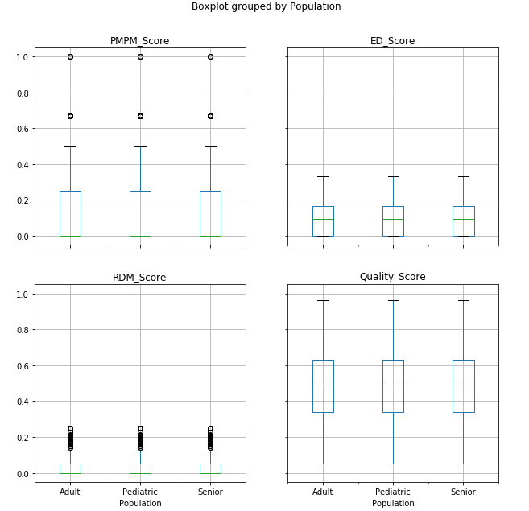
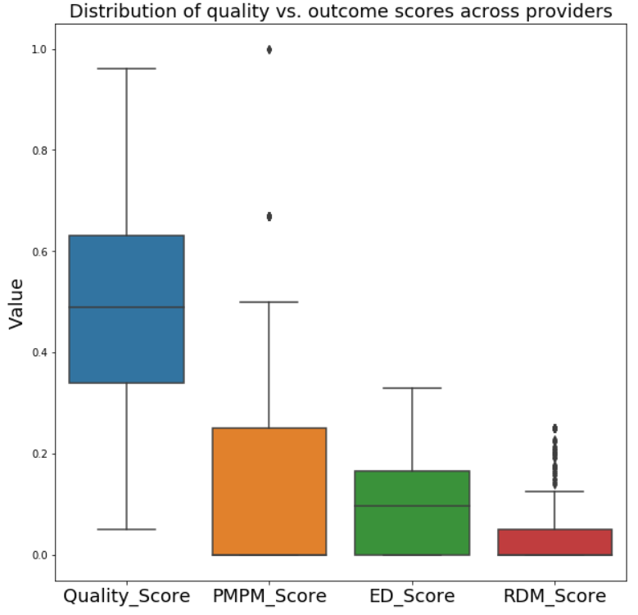
Exploratory Data Analysis – Score Distributions

Slide 8
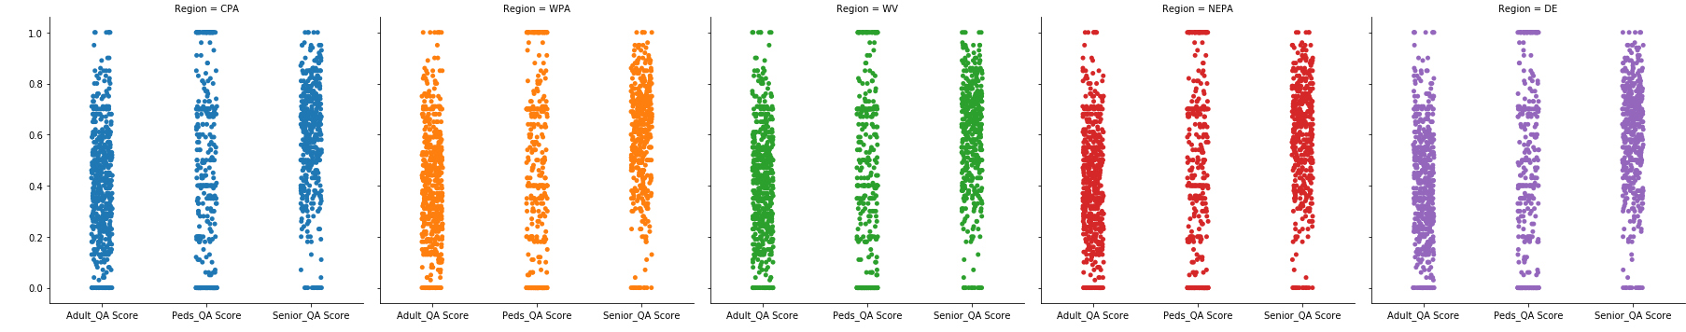
Quality Scores per Region
QA Score per Region per Population
Number of Providers per Region
Western PA – 177
Central PA – 122
Northeast PA – 104
West Virginia – 85
Delaware – 78

Slide 9
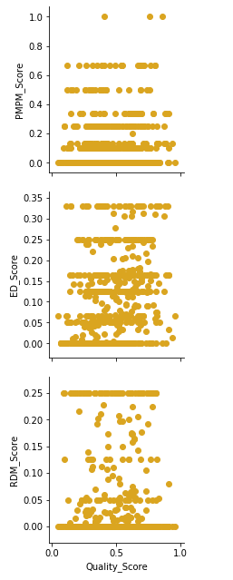
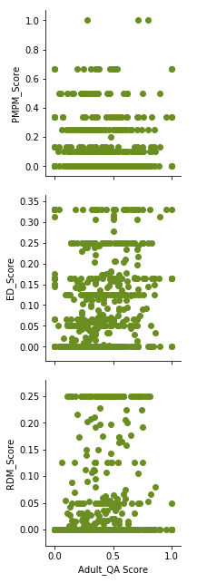
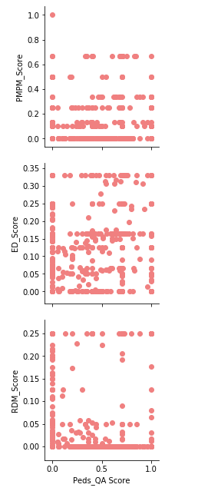
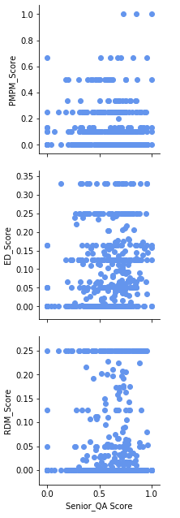
Quality versus Outcome Scores

Slide 10
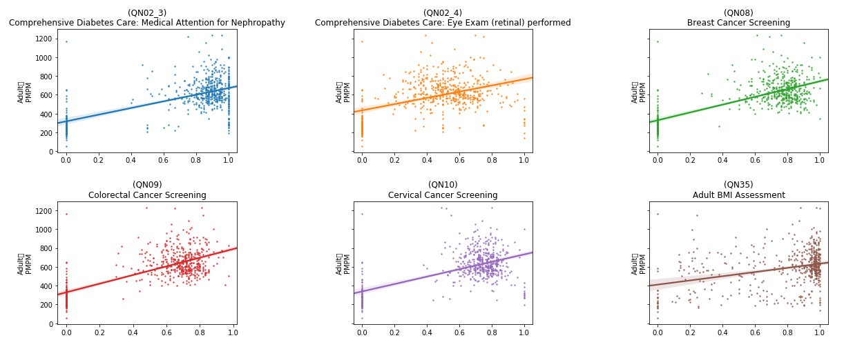
Rates (raw QA scores) versus Adult PMPM

Slide 11
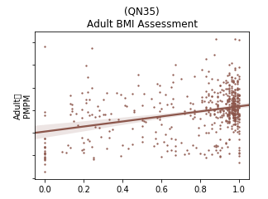
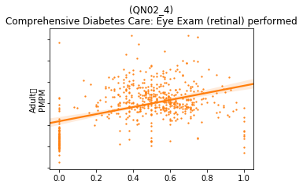
Rates versus Adult PMPM – Zoomed In
Adult
PMPM
Adult
PMPM
High variability
Low confidence

Slide 12
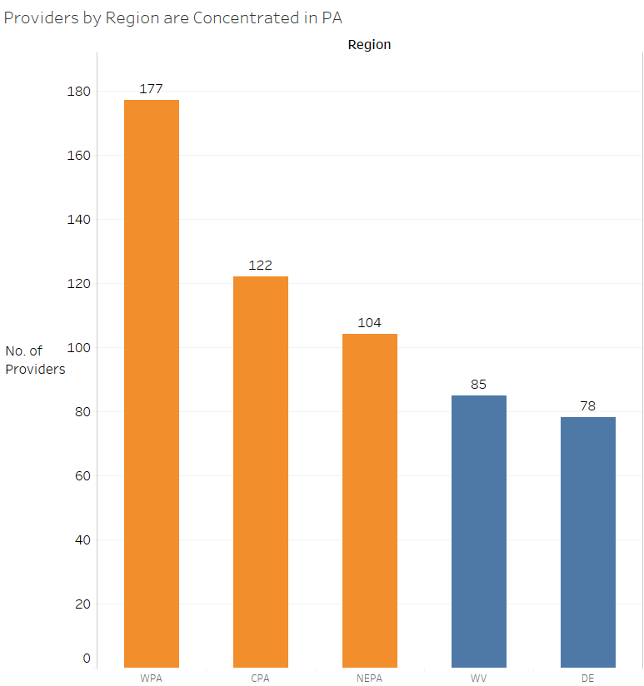
Providers by Region

Slide 13
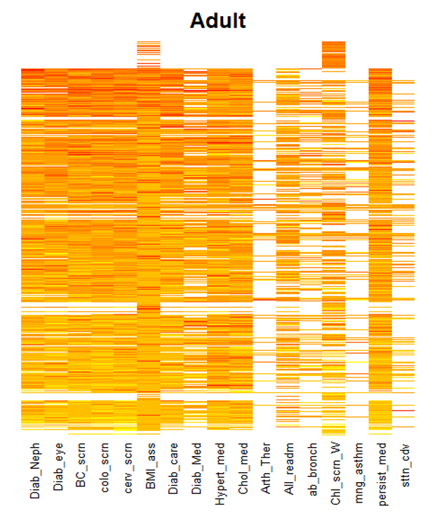
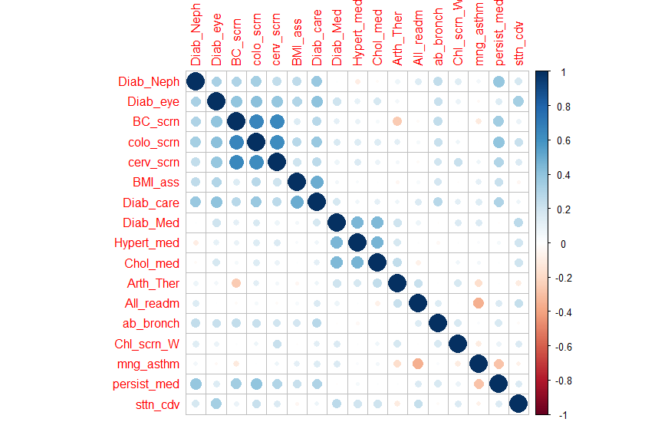
Correlation between QA metrics – Adult Population
Providers with decreasing QA scores

Slide 14
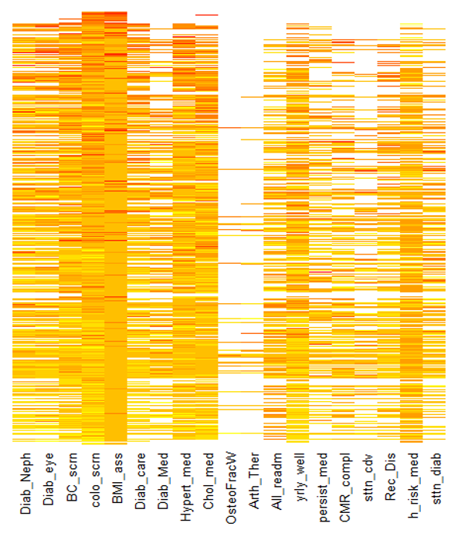
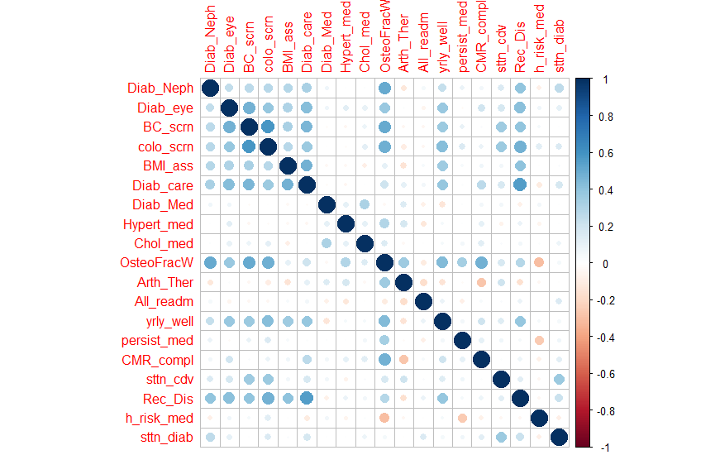
Correlation between QA metrics – Senior Population
Providers with decreasing QA scores

Slide 15
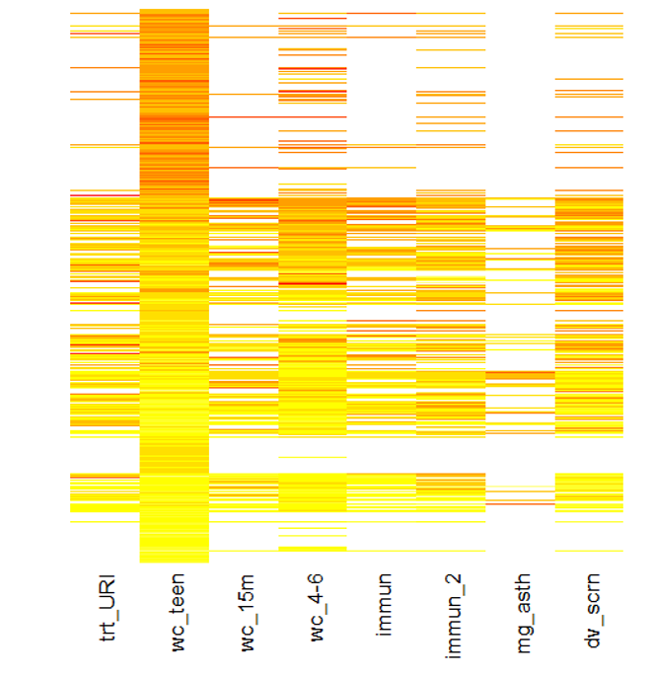
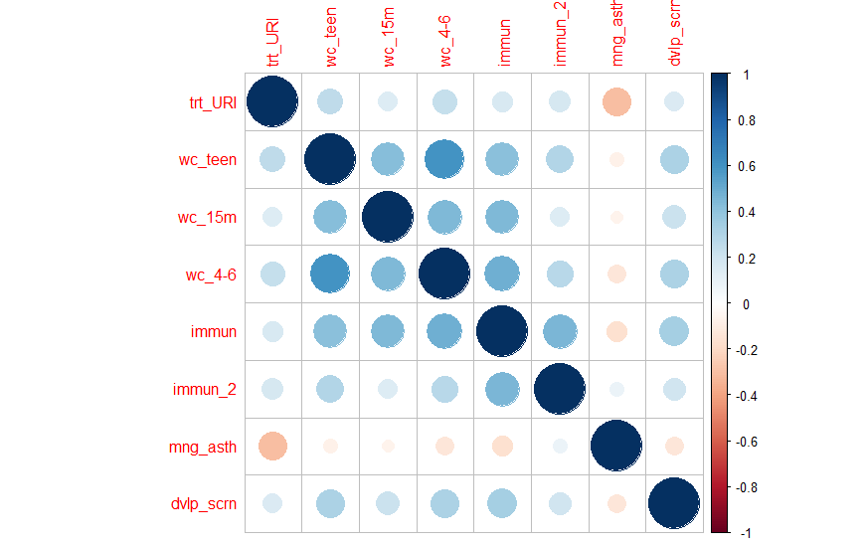
Correlation between QA metrics – Pediatric Population
Providers with decreasing QA scores

Slide 16
Next Steps
Deep inspection of differences across providers
Region
Population
Number of members
Dimensionality reduction
PCA to reduce multicollinearity between metrics
Key driver analysis
Multiple linear regression
Predictive models, if possible
Linear / lasso regression
Random forest / regression tree

Slide 17

Questions?

